Slide 1
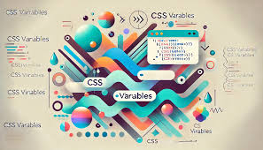
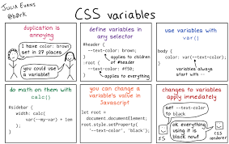
CSS VARIABLES
PRESENTED BY - (MD KAIF)

Slide 2
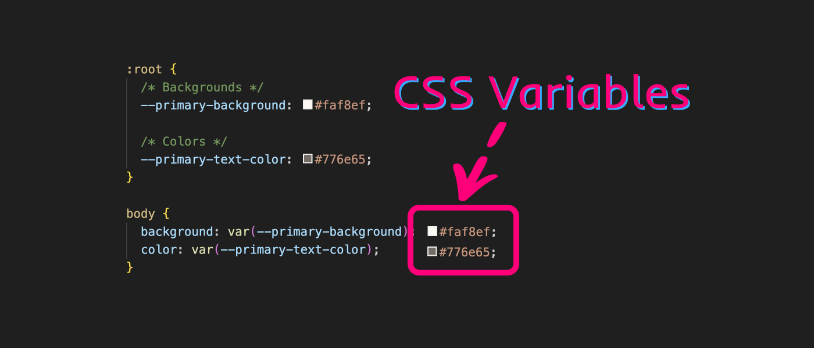

WHAT IS CSS VARIABLES
Css variables are user-defined values that can be stored in one place and reused throughout a CSS stylesheet, allowing developers to manage and change styles more easily by updating a single variable instead of modifying multiple places in the code; essentially acting like variables in traditional programming languages but specifically for CSS styling.

Slide 3

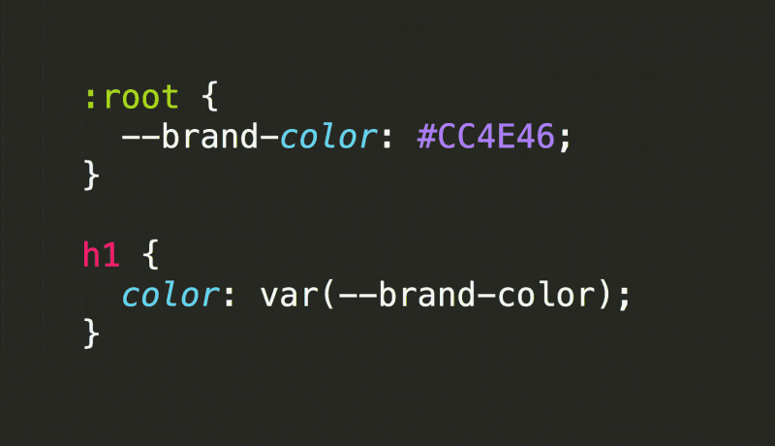
WHY WERE CSS VARIABLES CREATED. ?
:
CSS variables were created to enable developers to define reusable values within a stylesheet, allowing for easier maintenance and code organization by centralizing style settings and enabling quick updates to multiple elements by changing a single variable, rather than modifying each individual style declaration separately; essentially reducing redundancy and improving code readability.
.

Slide 4
FEATURES OF CSS VARIABLES
1.
Reusability:
Store a value once and reference it multiple times across different CSS rules, minimizing code repetition.
Slide.
2.
Amespace with double-dash prefix:
Variables are named with a double hyphen to distinguish them from standard CSS properties (e.g., --primary-color).
3.
Accessibility:
Use variables to manage color schemes, ensuring consistent accessibility across different elements.
Hint:

Slide 5
WHY ARE CSS VARIABLES ARE IMPORTANT. ?
Reducing repetition: CSS variables can help reduce repetition by allowing you to define a value in one place and then reference it in multiple places.
Dynamic styling: CSS variables allow you to change page style elements without reloading the page. This is especially useful for responsive design.
Enhanced readability: Descriptive variable names improve code clarity and understanding

Slide 6
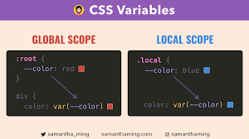
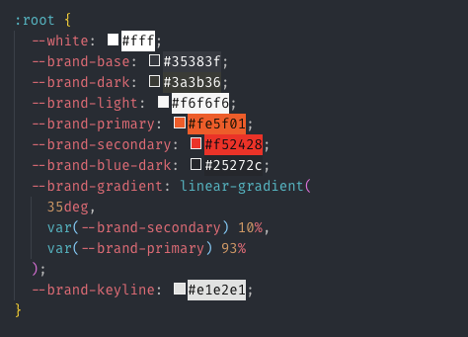
SOME PICTURES OF CSS VARIABLES

Slide 7
BENEFITS OF CSS VARIABLES
Maintainability: Changing a value in one place updates all instances where the variable is used.
Flexibility: Variables can be manipulated through JavaScript, enabling dynamic styles.
Reduced Redundancy: Common values can be stored once and reused multiple times, minimizing repetitive code.

Slide 8
THANK YOU

